Slide 1
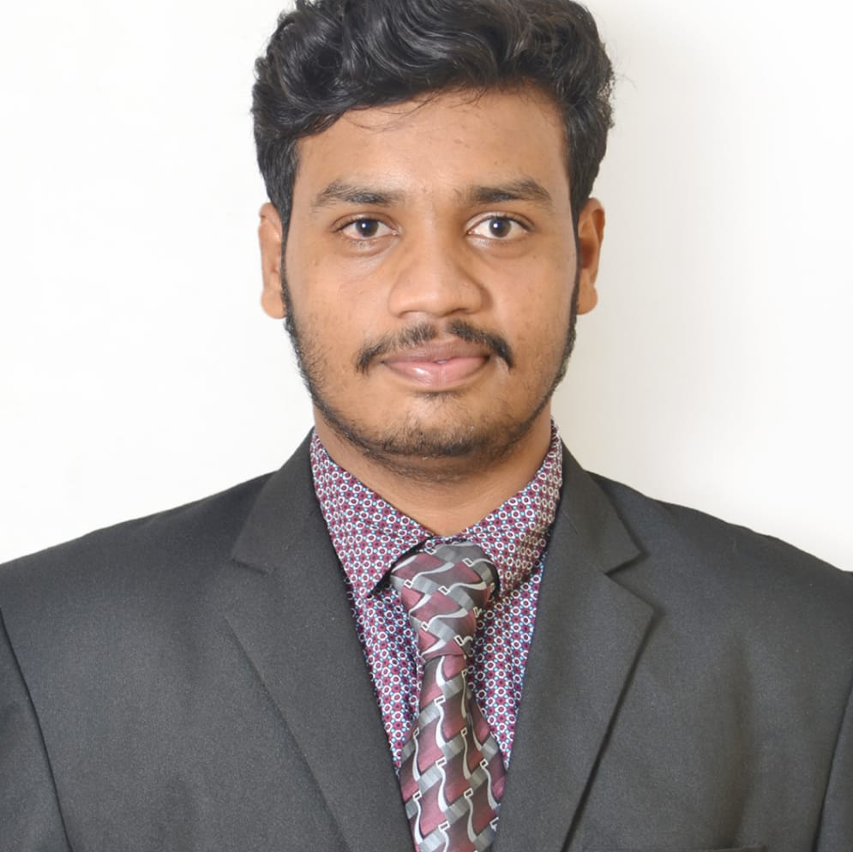
Mukthesh R
Analyst/Software Engineer
Bachelor of Engineering
Electronics and Communication: 2018 - 2022
Skills Java 8
Spring Boot
Spring MVC
JPA CRUD
Spring Boot Microservices
MERN Stack
ReactJS
MongoDB
Database
MongoDB Database
Web Technologies
HTML5
CSS3
JavaScript
Add-ons
GitHub
Maven
Postman
Additional Details
Excellent Communication Skills
Team Player
Mumbai
MUKTHESH. R@CAPGEMINI.COM
+91 9515217724
A4
Software Engineer who is Strong in design and integration with intuitive problem-solving skills. Passionate about implementing and launching new projects.
Hands on experience in microservices with Spring Boot, Spring Security, Spring API Gateway, Eureka server.
Always ready to learn new technologies and so can improve my knowledge.
Ready to work in a team and to perform my level best for my team.
Railway Reservation System
Completed end to end case study of Railway Reservation System along with JWT authentication, Swagger, Payment, testing and used REACT.
Created a Frontend of Railway Reservation System using ReactJS, JavaScript, Html , Css and used MongoDB as database and git as version control
Completed AWS cloud practioner certification(AWS CCP).
Completed Google Cloud Digital Leader Certification(GCP CDL).

